Slide 1
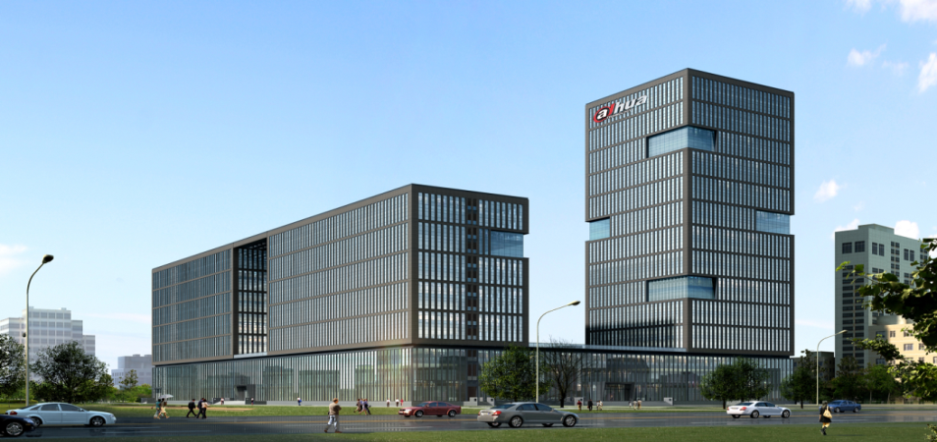
Intelligent Face Recognition

Slide 2
-CONTENTS-
1
2
3
Background
Introduction
Application

Slide 3
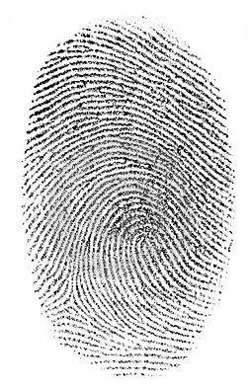
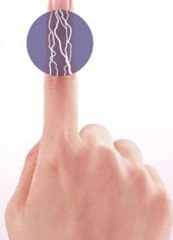
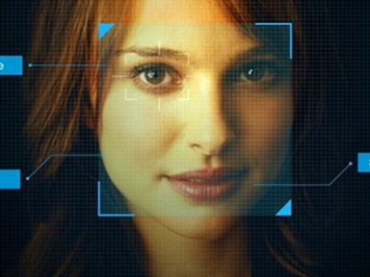
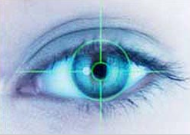
Background | Biometric Identification Technology
Biometric identification technology becomes more and more popular in the industry, for example, Finger Print, Face, Iris, Finger Vein and so on.
It’s convenient for us to recognize the personnel identity by arithmetic comparison of the unique features we searched, which improve the security and timeliness.
Finger Print
Finger Vein
Iris Features
Face Features
Notes:
Biometric identification technology becomes more and more popular in the industry, for example, finger print, face, iris, finger vein and so on. It’s convinent for us to recoginise the personnel identity by arithmetic alignment of the unique characters we searched, which improve the security and timeliness.

Slide 4
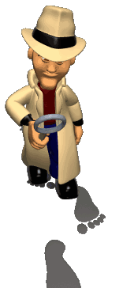
Background| Face Recognize
Advantages of Face Recognize：
Human Cognitive Habits
Everyone recognizes faces every day.
Rich Information
Face expression, Age, Gender and so on.
Concealment Operation
Especially suitable for various applications such as video surveillance and capture
Gathering In A No Infringement Type
Easy to accept for users because it needn’t direct contact

Slide 5
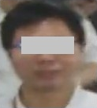
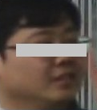
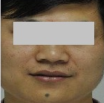

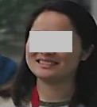
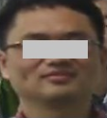
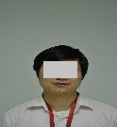
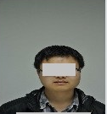
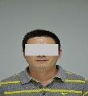
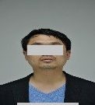
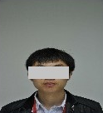
Background| Recognize Process
Gather Information
Comparison
1010101010
0101010101
1010101010
0101010101
Score：86
Feature Extraction
Video Surveillance
Face Detection
Face Quality Evaluation
Modeling
Characters Library
Name：XXX
Similarity：98%
1010101010
0101010101
1010101010
0101010101
Recognize results
1：N Character Comparison
Feature Extraction
Face Pictures
Modeling
Face Features Library

Slide 6
-CONTENTS-
1
2
3
Background
Introduction
Application

Slide 7
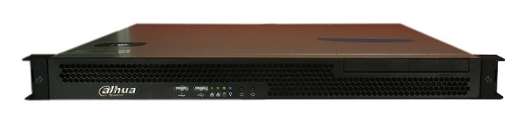
Introduction | Parameters
DH-IVS-F7200
Combine the face detection, face image comparison, face image search and database functions together
Dynamic comparison register library support up to 300,000 image
Real time compare the capture face image with the image in register library, support single or batch export
Search the comparison result according to time or location, support single or batch export
Support add, delete, modify and search the register library, batch import and export
DH-IVS-F7200
Notes:
Combine the face detection, face image comparison, face image search and database functions together.
Build-in MYSQL database.
Used with DSS platform.
Detect the face in designated region, tracking the move track, save the face image and the overall image which include this face.
Search the capture image according to time or location, support single or batch export.
Real time compare the capture face image with the image in register library, and show multi person information which is most similar, including alarm time, location, similarity.
Search the comparison result according to time or location, support single or batch export.
Dynamic comparison register library support up to 300,000 image.
Detect the face from image automatically, and compare with register face library, search multi person information and order by similarity, support single or batch export.
Comparison server can support up to 4 channel 1080P at the same time.
Detect face of the designated image, and compare with capture face library, search the relevant person information, order by similarity, support single or batch export.
Rechecking the designated register library and search the relevant person information, order by similarity, support single or batch export.
Support add, delete, modify and search the register library, batch import and export.

Slide 8
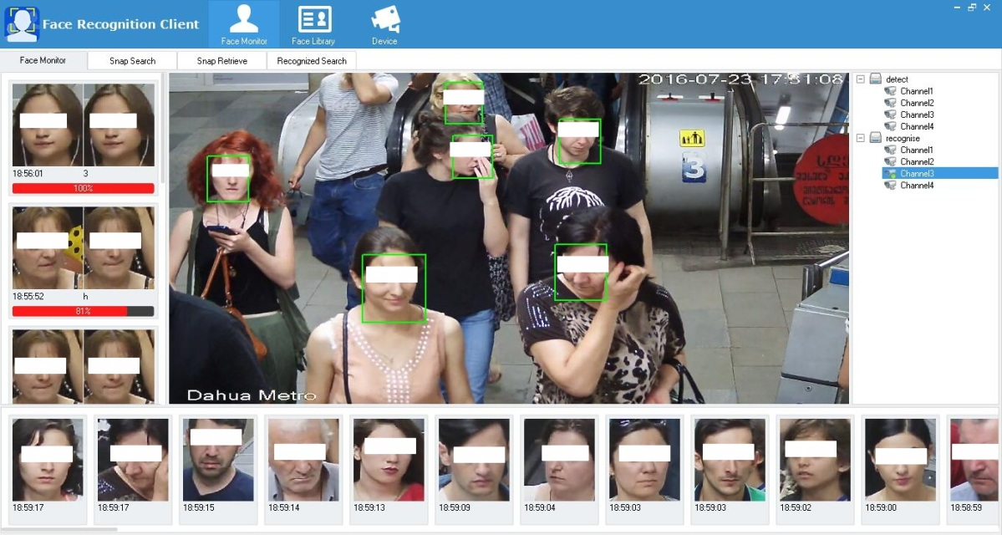
Introduction | Real-time Face Capture
Face Detect、Tracking
Automatic face detection and tracking
Face image quality evaluation
The optimal face capture and save storage
Capture face database query
Export batch capture images
Apply to gather face Information at key passageway
Face Capture

Slide 9

Introduction | Real-time Face Comparison
Comparison Results
Face feature fetch
Feature real time comparison
Comparison result show
Export batch capture images
Apply to sensitive crowd control at key passageway

Slide 10
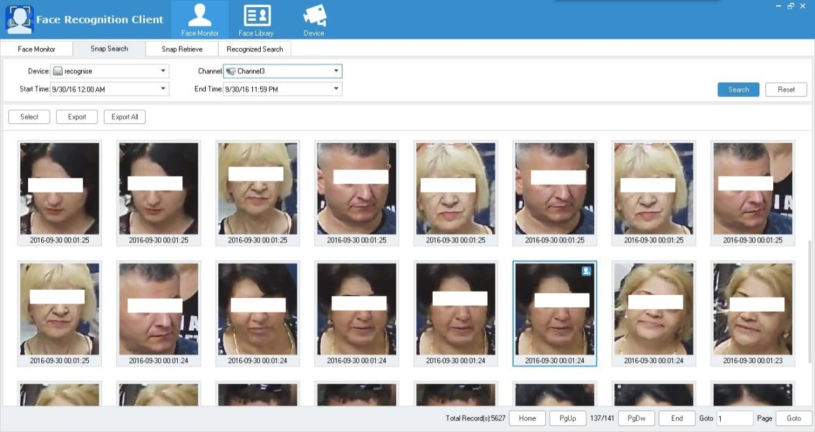
Introduction | Snap Search
Set Query Conditions
Automatic face detection and tracking
Face image quality evaluation
The optimal face capture and save storage
Capture face database query
Export batch capture images
Capture Results
Apply to gather face Information at key passageway

Slide 11
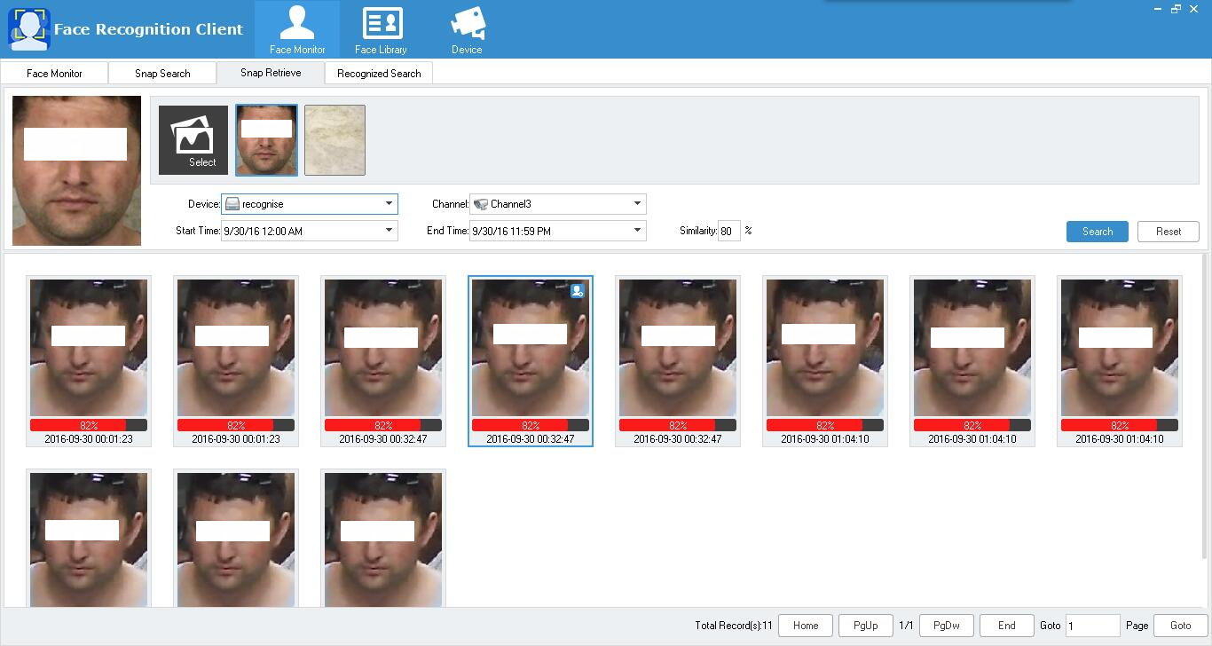
Introduction | Snap Retrieve
Face detect automatically
Picture comparison
Compare results show
Sort by similarity
Retrieve Condition Setup
Recheck & Track
Retrieve Results

Slide 12
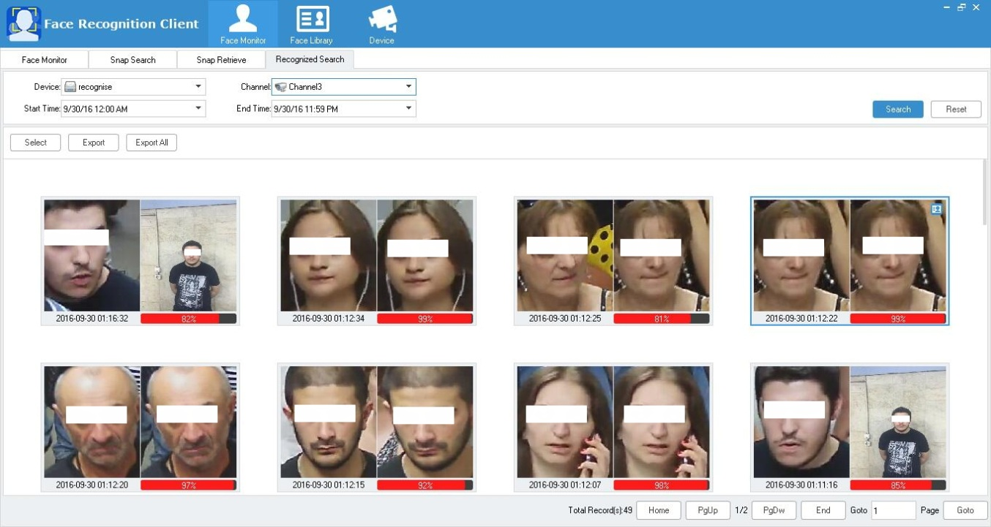
Introduction | Recognition Search
Retrieve Condition Setup
Face feature fetch
Feature real time comparison
Comparison result show
Export batch capture images
Apply to sensitive crowd control at key passageway
Retrieve Results

Slide 13
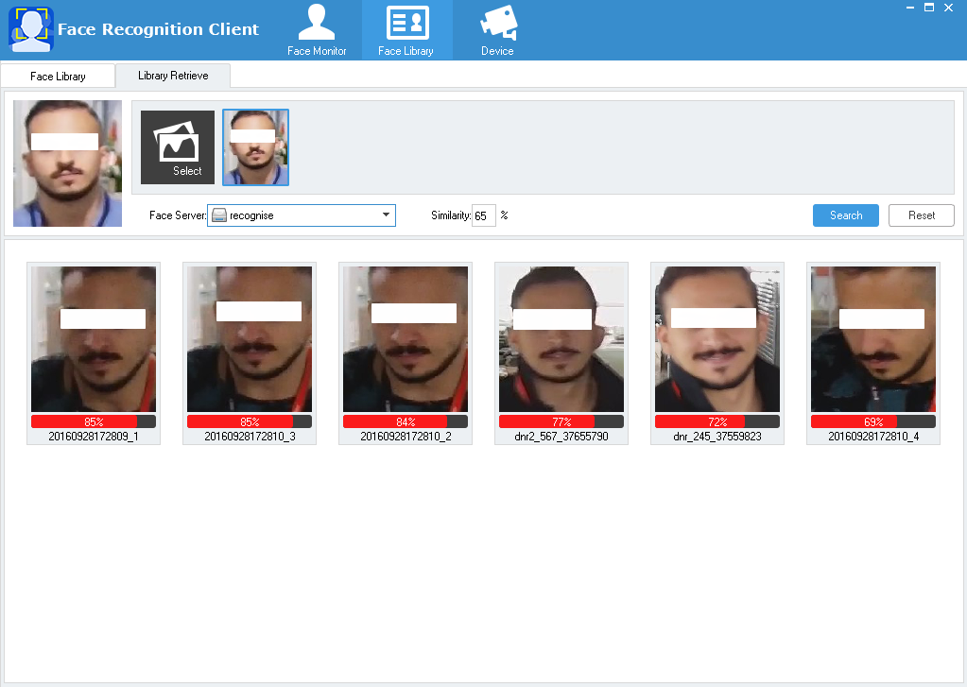
Introduction | Register library search
Automatic face detection
Image comparison with register library
Show Comparison result
Order by similarity
Export batch capture images
Retrieve condition setup
Apply to information confirmation of no information person
Register library search results

Slide 14
-CONTENTS-
1
2
3
Background
Introduction
Application

Slide 15
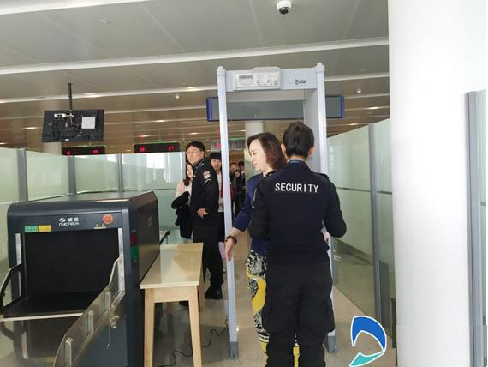
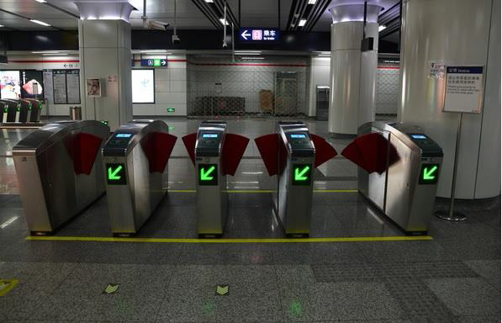
Application| Industry Application Example
Safety Inspection
Gate Entrance

Slide 16
Application| System Architectures
Industry
Application
……
Subway
Airport
Market
Bank
Face
Recognition
Compare
Capture
Retrieve
Storage
Features
Modeling
Compare Library
Capture Library
Retrieve Library
Initial
Database
……
Other Library
VIP Library
Control Library

Slide 17


Application| System Architectures
IPC
Hard Disk
Picture Storage
DH-IVS-F7200
IPC
Real-time
Capture Module
Database Module
Face Pictures
Video
Face Features
IPC
Capture Face Picture
Feature Import
Features Import
Compare Module
Search Module
IPC
Database Management
Retrieve Upload
Compare Results Upload
Search Request
Capture Info. Upload
Compare Results
Client

Slide 18
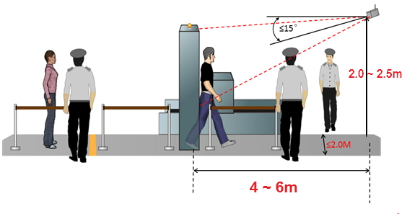
Application | Camera Installation

Slide 19


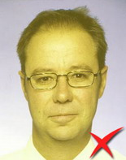
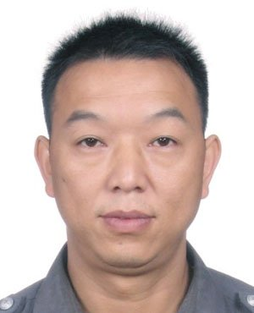
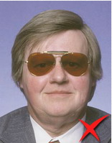

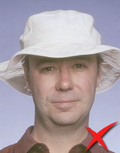
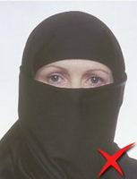
Application | Face Image Request
No backlighting face no obvious reflection
Light even and no shadow
Pupillary center distance
More than 50 pixels
Light Request
No sunglasses, scarf, hat and other shade facial decorations.
Glass frame, hair don't keep out eyes
Face size more than 100*100 pixels
Left and right rotate[-30°,30°]
Elevation angle[-15°,15°]
Plane rotate[-15°,15°]
Others
Face image gesture and size request

